Slide 1
Taking it Higher: Improving Instruction with the High Quality Instructional Cycle
Stephanie Patton
October 8, 2021

Slide 2
Success Criteria
Learning Intentions | Success Criteria
Participants will understand the six steps of the High Quality Instruction (HQI) cycle. | I can name the six steps of the High Quality Instruction (HQI) cycle.
 | I can identify an area of weakness within the HQI cycle that I will focus on improving.

Slide 3
What are the key elements in the design, delivery, and reflection process of high quality instruction?

Slide 4
High Quality Instructional Cycle

Slide 5
How did your list compare to the HQI Cycle?

Slide 6
Step 1: Goals and Outcomes
Learning Intentions
Success Criteria
High expectations

Slide 8
Learning Intentions | Success Criteria
Participants will appreciate formative assessment as an intentional process. | I can describe how to use a given assessment strategy as part of the formative assessment process.
Participants will understand key components of the formative assessment process and how each contributes to student-centered practices and supports use of multiple methods for demonstrating competency. | I can identify the role of the following in the formative assessment process: Learning Progressions Eliciting and analyzing evidence of student thinking Using evidence and feedback to move learning forward

Slide 9
What’s the difference between learning intentions and success criteria?

Slide 10
Learning Intentions
Summarize the purpose of the learning experience.
Are shared and referred to throughout the learning experience.
Communicate the intended learning - what will learners know, understand, be able to do.
Allow learners to guide and self-monitor their progress through a lesson.
Provide a common focus for decisions that may be made as a result of the professional learning.
Learning Intentions Are Not
Stating the objectives or reviewing an agenda

Slide 11
Success Criteria
Success Criteria
Identify how you will know that learners have learned what you intended.
Are worded in measurable, observable, learner-friendly language (e.g. ”I can” statements).
Allow participants to actively participate and monitor their learning (e.g. breakout rooms, discussions, self-reflections).
Success Criteria Are Not
Focused on the success level to be achieved.
Point- or grade-based.

Slide 12
Are we setting the bar high enough?
“We do the best we can do. We love our students, and we want them to learn to read and write and think well. But home is chaotic, there isn’t always enough to eat, they have no books and magazines, they work two jobs, they have a family to look after, they’ve always struggled in school…the poor dears, what can we expect?”

Slide 13
High Expectations
Align with relevant standards
1
Convey a common vision for what attainment of learning intentions looks like
2
Convey the belief that all learners can achieve high levels of learning
3
Respect the professionalism and autonomy of adult learners
4

Slide 14
Step 2: Planning Instruction
Personalize
Accommodate
Scaffold
Activate Background Knowledge

Slide 15
Identify a particularly effective learning experience you have engaged in and what made the experience effective for you.

Slide 16
Personalized Learning
Customizing the learning experience for students, allowing them to learn according to their unique skills, abilities, preferences, background, and experiences.

Slide 17
Benefits
Helps learners feel valued and gain a sense of connection to what is being taught.
Involves students as active participants in their education.
Increases levels of engagement.

Slide 18
Personalized Learning Strategies
Choice Boards
Project-Based Learning
Tiered Learning Targets
Inquiry-Based Learning
Learning Stations
Goal-setting
Flexible seating arrangements
Flipped instruction
Mine their experiences

Slide 19
Accommodations
“Accommodations are practices and procedures that provide equitable access during instruction and assessments for students with disabilities that do not alter the validity, score interpretation, reliability, or security of the assessment. Accommodations are intended to reduce or even eliminate the effects of a student’s disability; they do not reduce learning expectations.”
Utah Participation and Accommodations Policy 2020-2021: https://www.schools.utah.gov/file/8bb3543b-5b56-4ebf-b4c2-40d84aa30b9b

Slide 20
Accommodations
An accommodation is not:
A change to the content of instruction or performance expectations for students
An interference or major change to the standards specified for students
An alteration to the big idea or major learning outcomes expected of the instruction
IRIS Center: Accommodations. https://iris.peabody.vanderbilt.edu/module/agc/cresource/q2/p11/#content

Slide 21
Examples of Accommodations
Instructional Accommodations
Provide graphic organizers.
Pair talking with writing.
Multiple ways to respond; e.g., verbal vs. written
Provide lesson notes to students.
Provide key terms and definitions in advance.
Reduce the number of responses students must submit.
Provide additional time to complete sessions and/or assignments.
Reduce distractions.
Materials Accommodations
Ensure text is accessible for students (consider reading level, language, and/or visual needs).
Ensure video/media is captioned and described (including captions in native languages).
Assistive Technology
Text-to-speech device integration.
Digital note-taking tools.

Slide 22
Scaffolding

Slide 23
Scaffolding Strategies
Chunking
Modeling Process or Product
Graphic Organizers
Pre-teach Vocabulary

Slide 24
What are some effective strategies for activating student’s background knowledge?

Slide 25
Activate Background Knowledge
Think-Pair-Share
K-W-L Charts
Make Predictions
Formative Pre-assessments
Jigsaw or Carousel Brainstorming
Graphic Organizers
Notes:
Building vocabulary is important.

Slide 26
How are we reinforcing or reinventing students’ prior knowledge of what the school experience is?
Notes:
Is background knowledge always positive?

Slide 27
How did the positive learning experience you identified earlier embed personalized learning to help make the experience meaningful?
or
How might the experience have been more beneficial if it had offered personalized option(s)?

Slide 28
Step 3: Instruction
Student agency
Customized Supports
Opportunities to read, write, speak, and listen
Provide multiple opportunities to show mastery over time

Slide 29
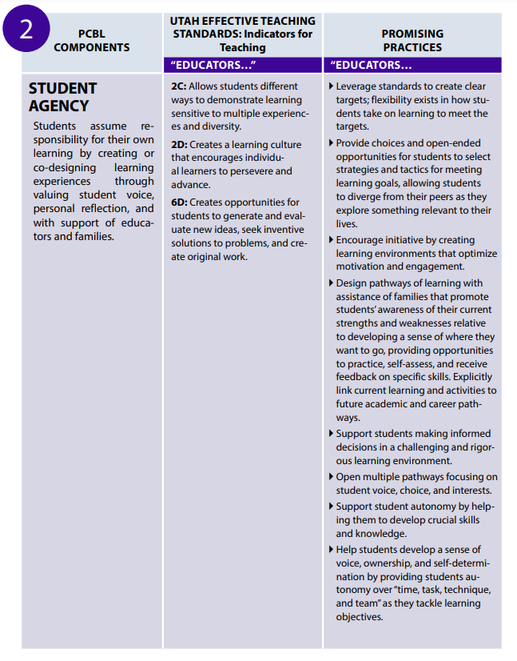
Student Agency

Slide 30
How might educators develop or advance student agency?

Slide 31
Customized Supports
Flexible Schedules
Just in time supports
Multiple formats
Feedback
Formative assessment
Notes:
Consider how to provide customized supports based on the UDL guidelines.

Slide 32
Reading, Writing, Speaking, and Listening
Using a post-it note, describe how you incorporate writing into your instruction.

Slide 33
Step 4: Assessments
Student-centered assessment practices
Multiple methods for demonstrating competency

Slide 34
What is Formative Assessment?
Focused on specific standards and learning intentions developed from learning progressions.
Provides clearly defined success criteria.
Connects the dots between instruction and student understanding.
Includes learning processes teachers engage in with their students to gather information during the learning process to improve achievement in learning
Provides data-informed instruction that generates effective data, effective discussion and conclusions, and effective action by BOTH students and teachers

Slide 35
Attribute of Effective Formative Assessment
Clear Learning Progressions
Learning Intentions and Success Criteria
Descriptive Feedback
Self and Peer Assessment
Collaborative Classroom Culture
Notes:
Learning progressions: articulate how learning intentions progress
Identifying and communicating learning intentions and success criteria throughout the learning
Providing descriptive feedback that does not include a score, linked to learning intentions and success criteria
Self and peer assessment provides opportunities for metacognition about learning
Collaborative classroom culture between teachers and students

Slide 36
Hypothetical Learning Intention & Success Criteria
Instructional Context: As part of a learning progression involving being able to compute and understand and effectively interpret the meaning of an average, students have previously demonstrated mastery of computation skills and are working on understanding what an average means.
Learning Intention | Success Criteria
Students will understand the meaning of an arithmetic average (mean). | I can explain how the mean acts as a point of balance among data values within the data set.

Slide 37
Exit Ticket A
Find the average of the following values:
17 20 0 30 40 22 32
Exit Ticket B
Explain why the calculation for finding the average of the following data would involve dividing by 7 rather than dividing by 6:
17 20 0 30 40 22 32
Why does the second exit ticket provide a more powerful contribution to the teacher’s formative assessment process?

Slide 38
Formative Assessment Strategies
Think-Pair-Share
Agreement circles
Socratic circles
Annotated student drawings
Card sorts
Chain notes
Concept maps
Four corners
Entrance/exit tickets
Guided reciprocal questioning
K-W-L charts
Graphic organizers—Four Square Notes
Dipsticks
Interviews
Rubrics
Checklists
Misconception checks

Slide 39
Step 5: Data and Reflection
Analyze and reflect on
Student errors and misconceptions
Outcomes
Use a variety of data

Slide 40
What types of data can we use to reflect on the efficacy of our instruction?

Slide 41
Step 6: Adapt Instruction
Extend and deepen learning
Provide appropriate interventions
Incorporate feedback

Slide 42
Evidence of student learning informs the next leg of the journey...
You are here.
Now what?
Notes:
Knowing where you are and how you got here is a important first step. Self-assessment and Peer Feedback helps us understand where we are on the trajectory toward our goal,. Making it actionable sets the next learning intention and success criteria - the next leg of the journey. Some call this: Feed Forward
Evidence of student thinking + self-assessment and peer feedback data = Evidence. which informs feedback and feed forward

Slide 43
Adding “Feed Forward” to your Feedback
Awesome! Your lowercase letters are all formed correctly. | Awesome! Your lowercase letters are all formed correctly. Tomorrow, I would like to see you work on the finger-space between your words so the reader can tell where a word begins and ends.
Nice work! Your essay followed the 5-paragraph format and your paragraphs were on topic and clear | Nice work! Your essay followed the 5-paragraph format and your paragraphs were on-topic. In the next revision, please include evidence from the text so your essay is even more convincing.
Yay! I can see that you followed all of the steps correctly. Thanks for showing your work | Yay! I can see that you followed all of the steps correctly. Thanks for showing your work. Next time, check your answer to avoid missing details like the negative sign.
Notes:
Effective feedback is specific and cites evidence of the student’s learning thus far and prompts the student toward the next learning progression/step toward mastery

Slide 44
How have you seen feedback used effectively to inform the learner and move learning forward?

Slide 45
High Quality Instructional Cycle

Slide 46
What area can I strengthen? What is one action step I can take to strengthen that area?
Notes:
Is background knowledge always positive?

Slide 47
Thank you! Stephanie Patton stephanie.patton@schools.utah.gov

